Slide 1
THE MESSENGER THAT BITEs WITH THE GOSPEL
Hebrews 4:12
For the word of God is alive and active. Sharper than any double-edged sword, it penetrates even to dividing soul and spirit, joints and marrow; it judges the thoughts and attitudes of the heart.
Notes:
1

Slide 2
THE MESSENGER THAT
BITEs WITH THE GOSPEL

Slide 3
THE MESSENGER MUST BE BOLD
DANIEL 6:10
Now when Daniel learned that the decree had been published, he went home to his upstairs room where the windows opened toward Jerusalem. Three times a day he got down on his knees and prayed, giving thanks to his God, just as he had done before.
Notes:
3

Slide 4
THE MESSENGER MUST BE INTENTIONAL
ACTS 1:8
But you will receive power when the Holy Spirit comes on you; and you will be my witnesses in Jerusalem, and in all Judea and Samaria, and to the ends of the earth.”
Notes:
4

Slide 5
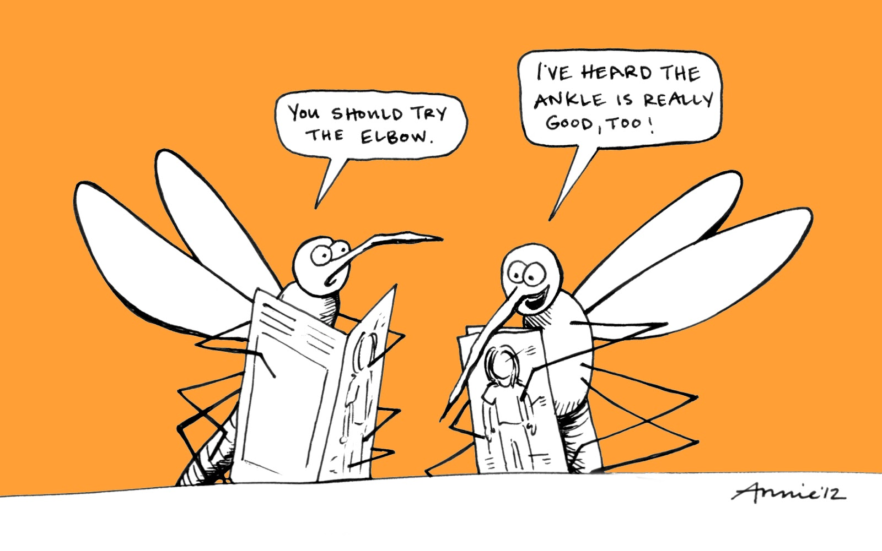
THE MESSENGER MUST BE TEAM ORIENTED
All the believers were together and had everything in common. They sold property and possessions to give to anyone who had need. Acts 2:44
Notes:
5

Slide 6
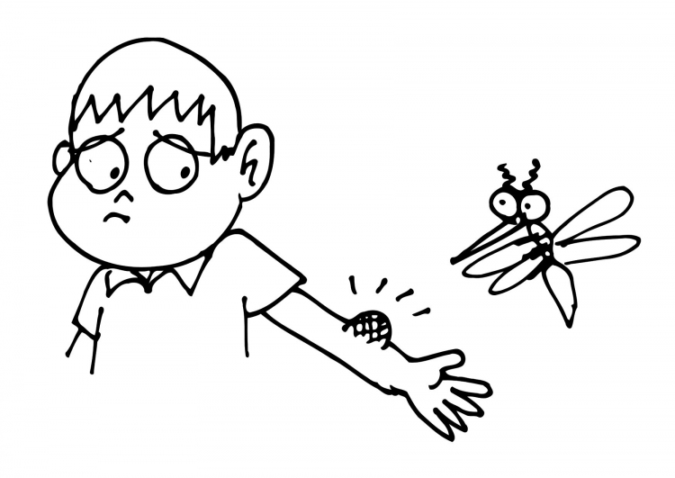
THE MESSENGER SHOULD EXPECT Results
ACTS 2:46-47
Every day they continued to meet together in the temple courts. They broke bread in their homes and ate together with glad and sincere hearts, praising God and enjoying the favor of all the people. And the Lord added to their number daily those who were being saved.
Notes:
6

Slide 7
THE MESSENGER THAT BITEs WITH THE GOSPEL MUST
BITEs
1. BE Bold
2. INTENTIONAL
3. TEAM ORIENTED
4. EXPECT AN EXPLOSION
Notes:
7

